Slide 1
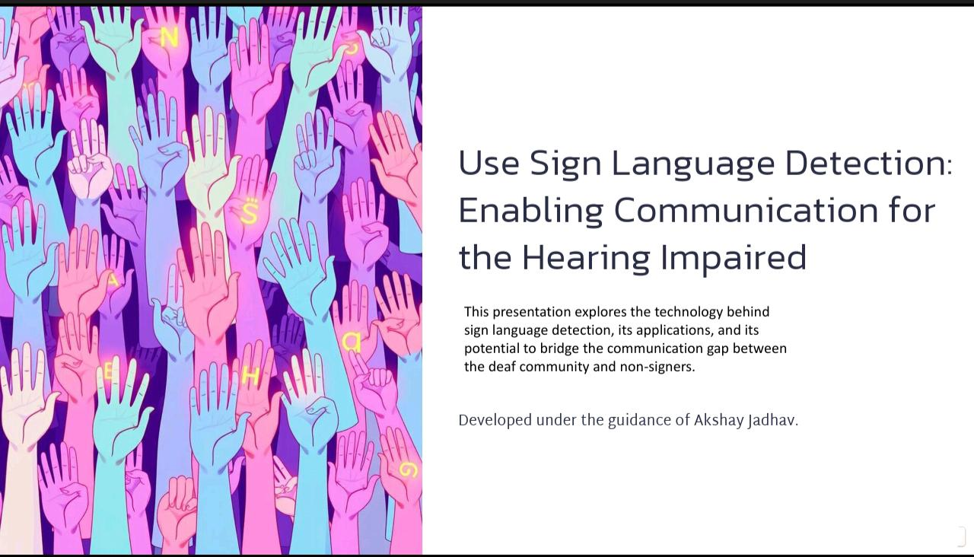



From Idea To Startup
Workshop
Topic :- Sign Language Detection
Using Computer Vision
Name of students:
Sourav Bhongade
Prajyot Gongale
Dip Agade
Ankush Nivalkar
Sarvadnya Amrutkar
Kunal Borkar
Under Guidance of
Akshay Jadhav
Sourav Bhongade
Prajyot Gongale
Dip Agade
Ankush Nivalkar
Sarvadnya Amrutkar
Kunal Borkar

Slide 2
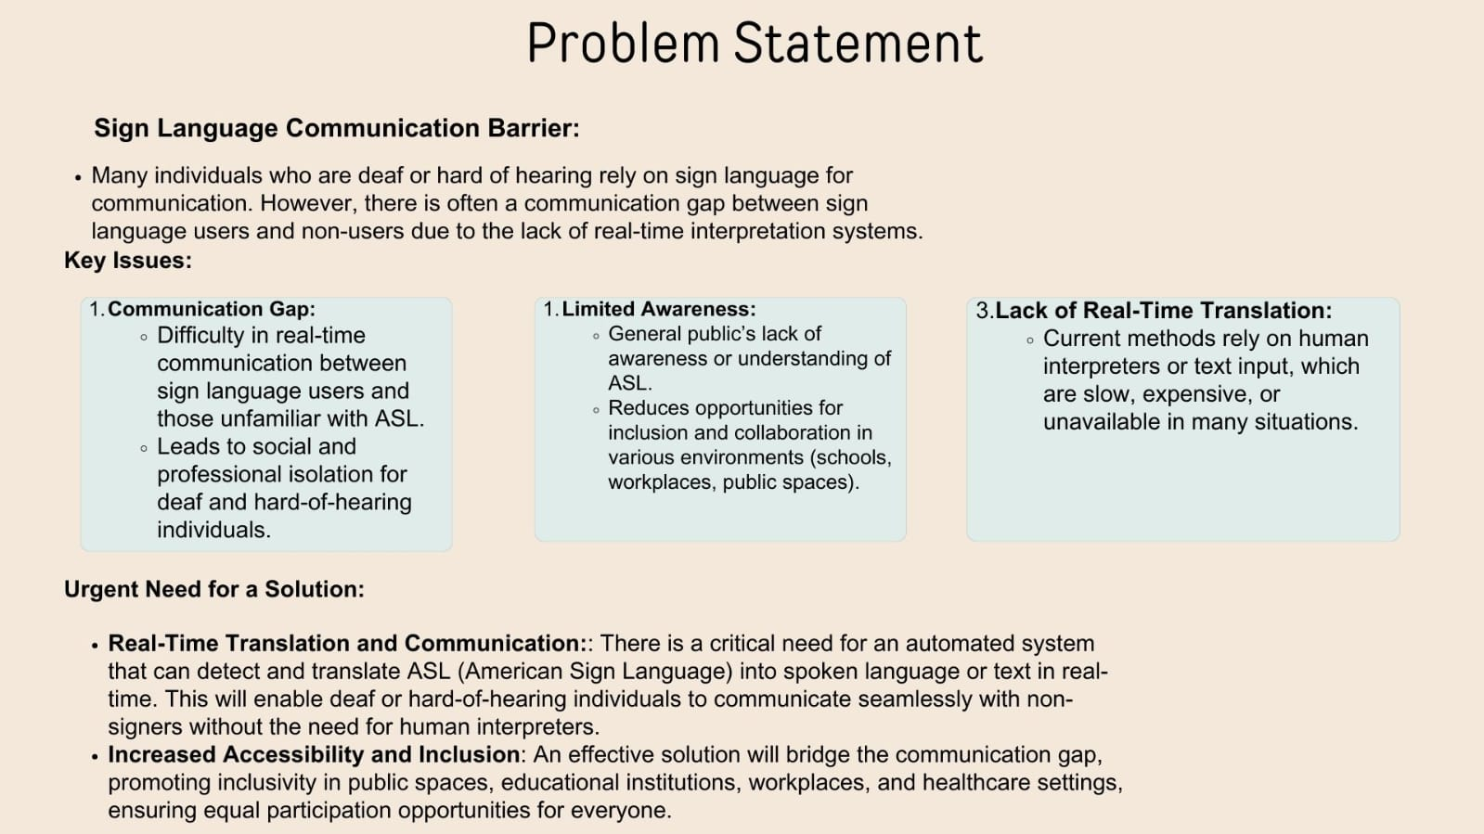

Slide 3
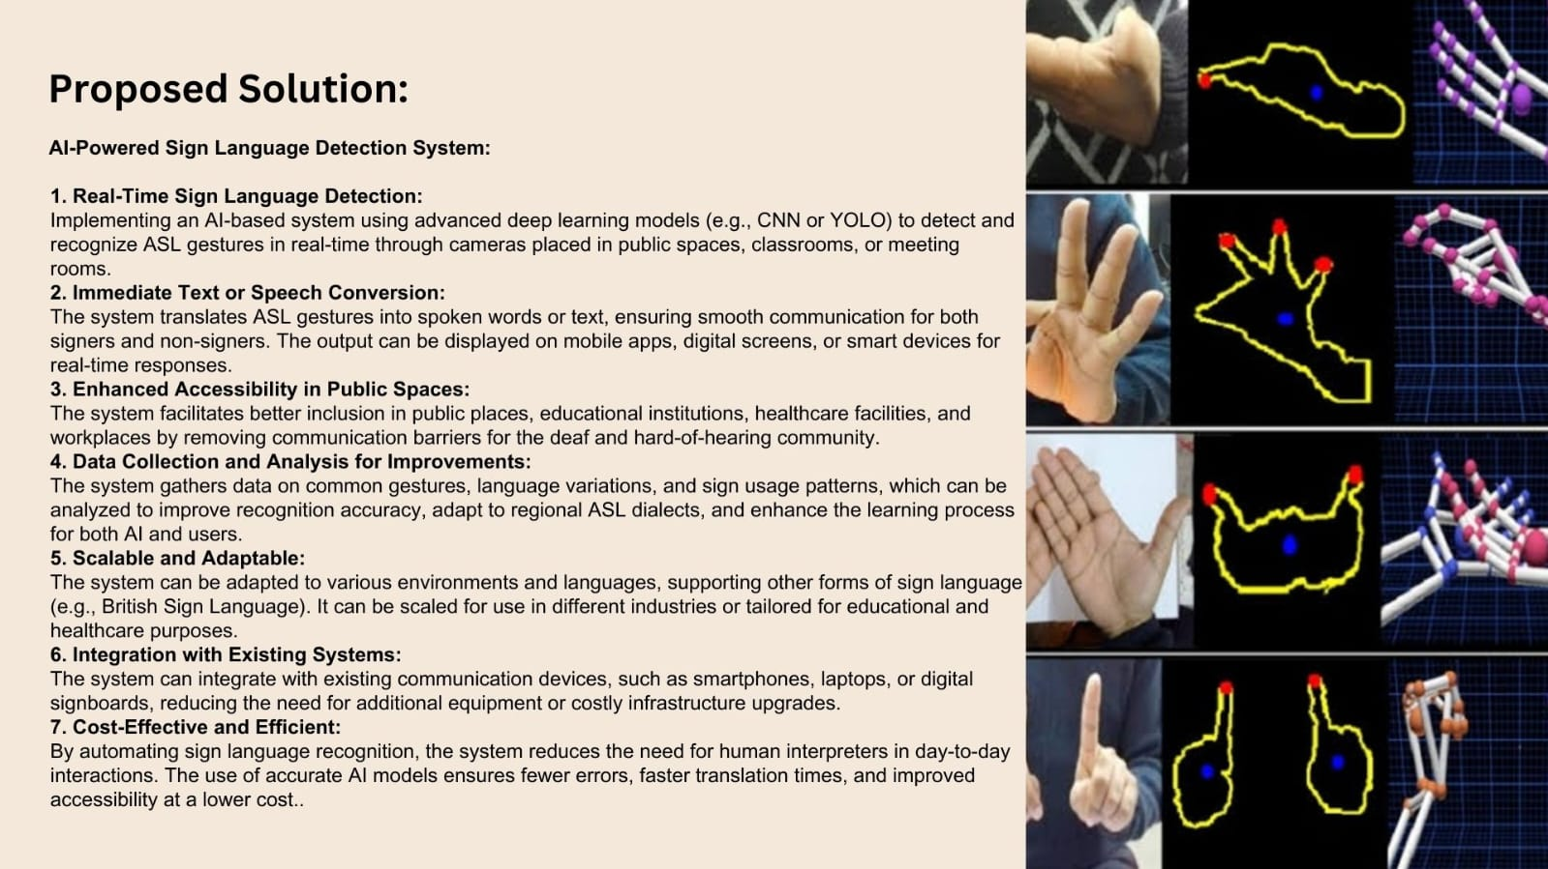

Slide 4
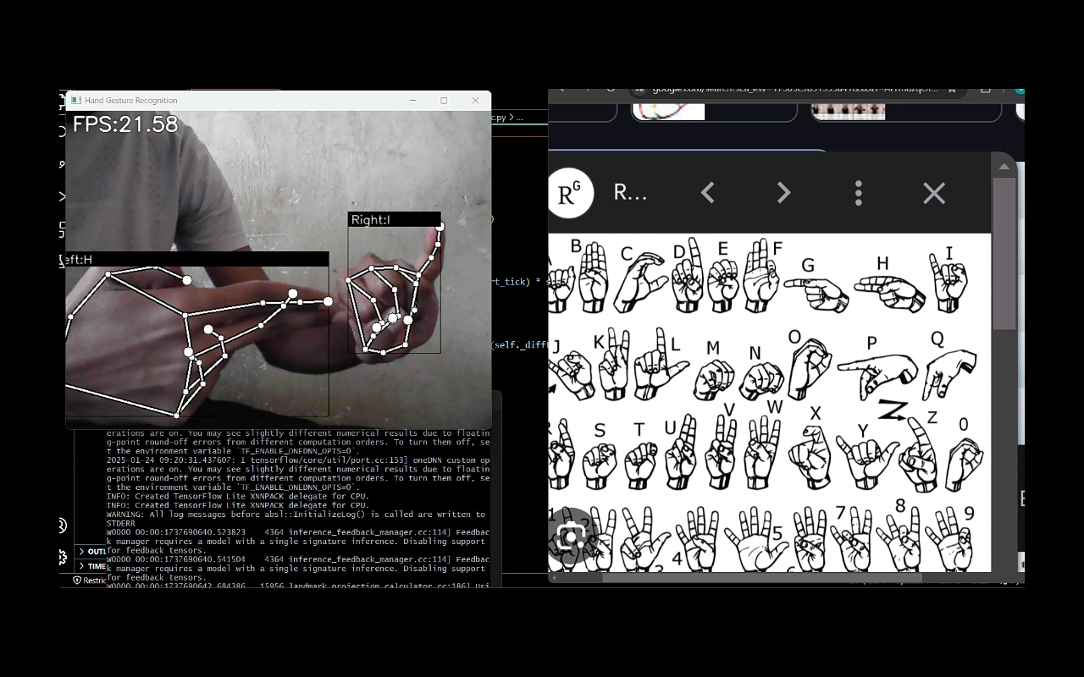

Slide 5
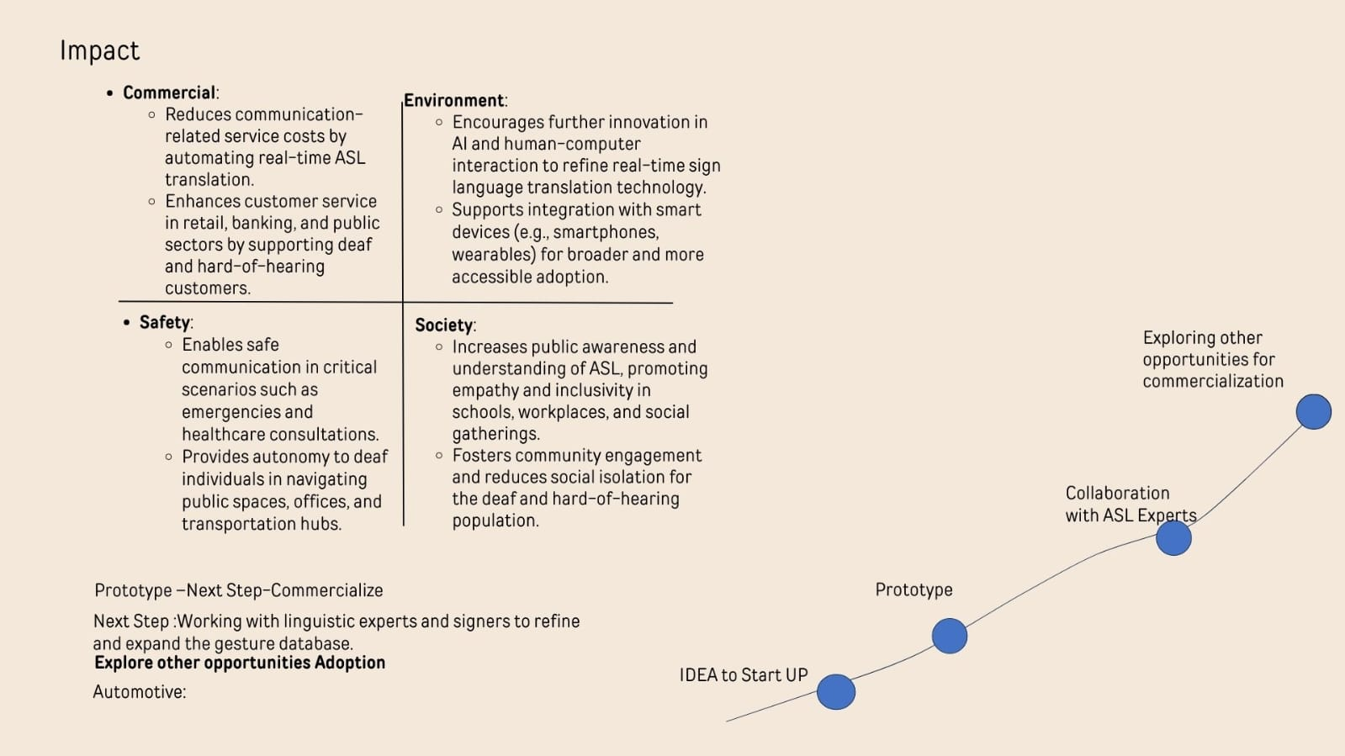

Slide 6
Introduction to American Sign Language (ASL)
Visual Language
Unique Grammar
ASL is a complete language, relying on hand gestures, facial expressions, and body language to convey meaning.
ASL has its own grammatical structure, distinct from spoken English, with spatial elements and verb conjugation using handshapes.
Notes:
2

Slide 7
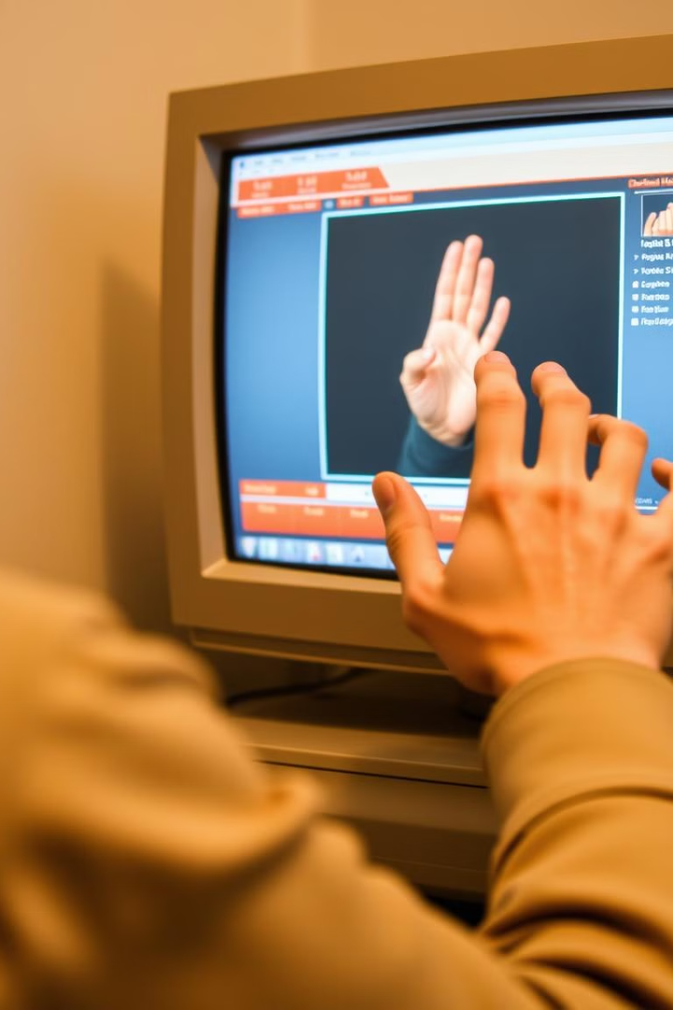




Real-Time ASL Detection and Demo
Input Capture
Live video feed is captured from a camera or webcam.
Sign Recognition
The trained model analyzes the video stream, identifying and classifying signs.
Output Display
The system provides real-time feedback, displaying recognized signs or translating them into text.
Notes:
7

Slide 8
Global Perspective
Hearing Impairment Statistics:
Over 1.5 billion people worldwide experience some degree of hearing loss; among them, approximately 430 million have disabling hearing loss requiring rehabilitation. Projections indicate that by 2050, over 700 million people will have disabling hearing loss.
Indian Context Hearing Impairment Statistics:
In India, approximately 63 million people suffer from significant auditory impairment, constituting about 6.3% of the population.
Market Size:
The global language translation device market is valued at approximately USD 1.49 billion in 2024 and is projected to reach around USD 4.02 billion by 2034, growing at a compound annual growth rate (CAGR) of 10.42%. Specifically, the sign language interpretation services market is estimated to be worth USD 0.76 billion in 2024, with expectations to grow to USD 1.63 billion by 2033, reflecting a CAGR of 8.5%.
Notes:
2

Slide 9
Potential Impact of the Wearable Sign Language Detection Device
Introducing a wearable device capable of translating sign language into audible speech could
:Enhance Communication: Facilitate real-time, offline interactions between sign language users and non-signers, bridging communication gaps.
Improve Accessibility: Provide an affordable and portable solution, increasing accessibility in education, employment, and public services.
Promote Inclusivity: Encourage social inclusion by enabling seamless interactions between deaf individuals and the broader community.
Existing Competition and Pricing
Several products aim to translate sign language into text or speech:
SR Robotics Sign Language Glove:
Description: An Arduino Nano-based glove designed to translate sign language gestures into text or speech.
Price: Originally priced at ₹7,000, currently available for ₹4,999.
Low-Cost Smart Glove by UC San Diego Engineers:
Description: A prototype developed using stretchable and printable electronics, capable of translating the American Sign Language alphabet and controlling virtual objects.
Cost: Built for less than $100.
Notes:
2

Slide 10
Challenges and Future Improvements
1
Data Variety
Acquiring a large and diverse dataset encompassing all ASL signs is challenging.
Real-Time Performance
2
Ensuring fast and accurate detection in real-time requires optimization for efficiency.
Sign Ambiguity
3
Distinguishing between similar signs or interpreting complex expressions presents challenges.
Notes:
8

Slide 11
References:
1. "Deep Learning for Sign Language Recognition"
By Siddharth Srivastava, Ujjwal Bhardwaj.
2. Chatgpt AI
3. Github
https://github.com/AkramOM606/American-sign-Language-Detection?tab=readme-ov-file#Features
https://en.m.wikipedia.org/wiki/Deafness_in_India
https://media.market.us/hearing-loss-statistics/?utm_source=chatgpt.com
https://nhm.gov.in/index1.php?lang=1&level=2&lid=606&sublinkid=1051&utm_source=chatgpt.com

Slide 12
Thank you for your time and consideration. We appreciate your interest in our sign language detection system and look forward to future collaborations.
Name of students:
Sourav Bhongade
Prajyot Gongale
Dip Agade
Ankush Nivalkar

